Slide 1
TORMA Biztonságtechnika
a presentation by Czéh Szabolcs, Gonda Ákos & Torma Enikő

Slide 2
Teamwork
Czéh Szabolcs – Backend
Gonda Ákos – Database, Documentation
Torma Enikő – Frontend

Slide 3
The Problem
Torma Security Ltd.’s website is outdated.
Customers don’t usually know what they need.
Hard to get an appointment.
No online presence

Slide 4
Our solution
A new modern website with better UX/UI
Configuration system according to customer needs
Online appointment booking
Online shopping oppourtunity which boosts sales

Slide 5
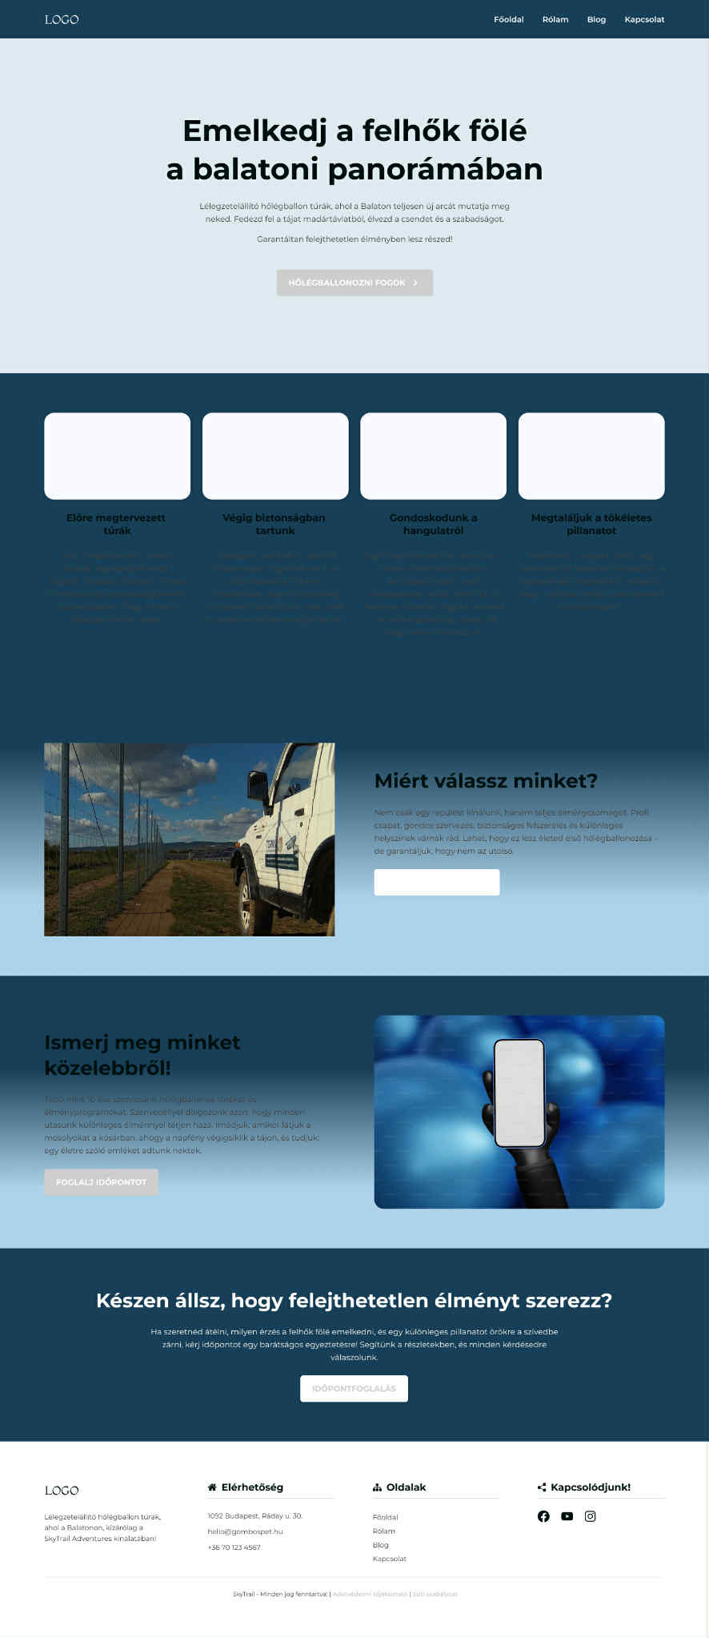
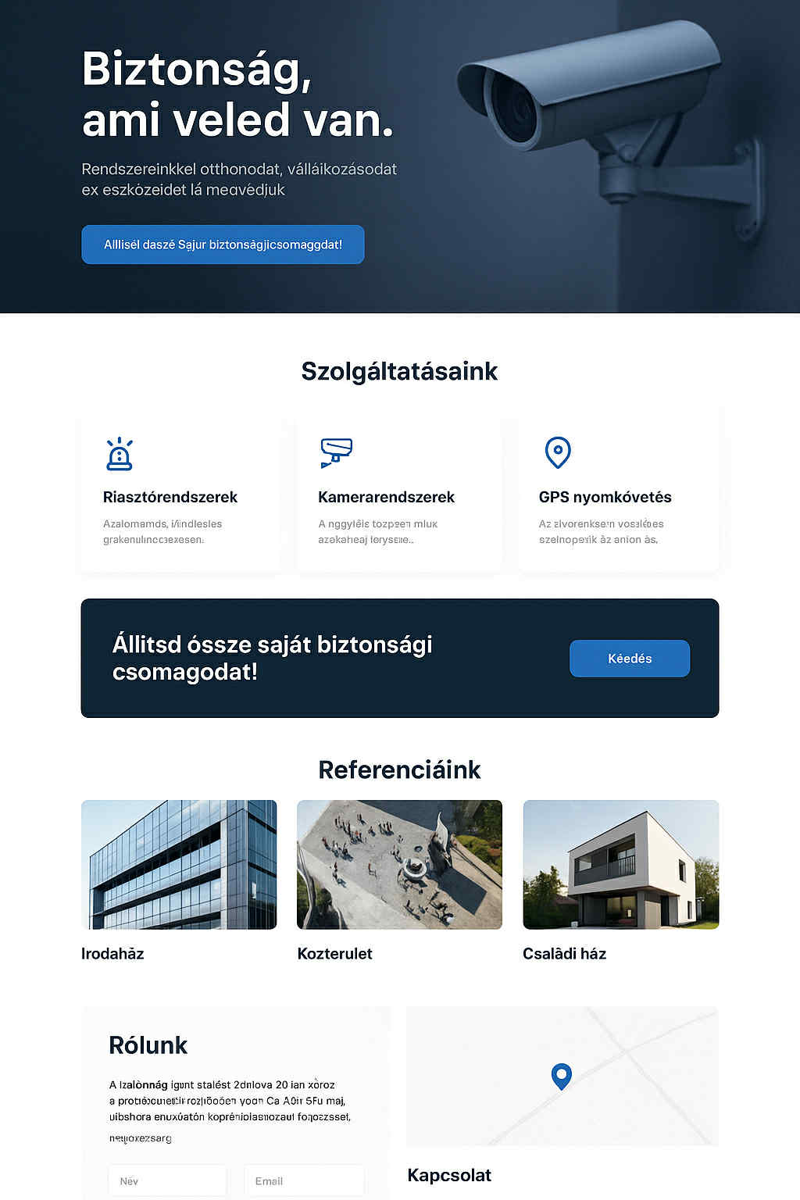
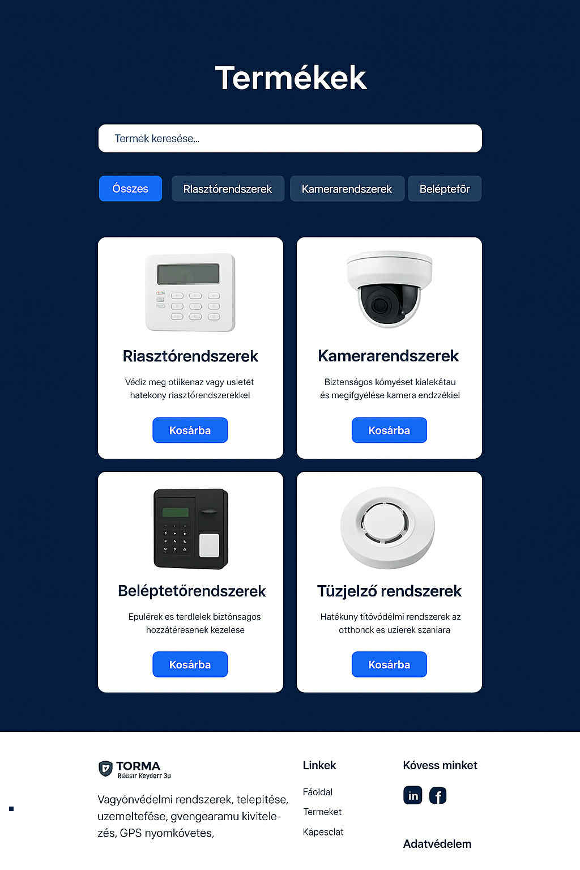
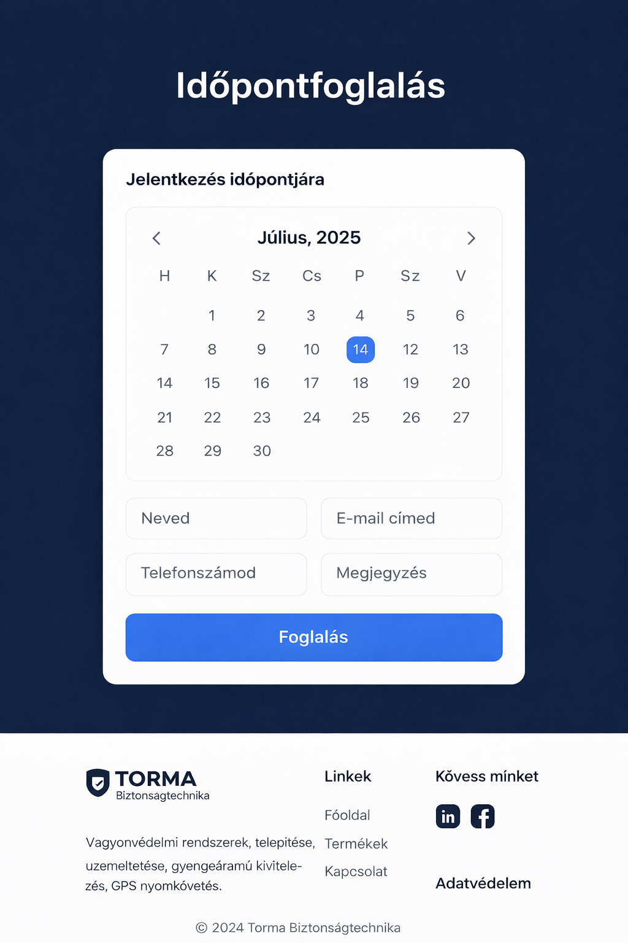
Design plan

Slide 6
Jira & Git - Project management
We are still working on this feature, but the design and concept are already defined.

Slide 7
Technologies used:
Scrum – Trackable deadlines
Jira – Timelines, Task tracking
Git – Version controller
Discord – Team communication

Slide 8
Testing
Screenshot of the testing documentation will be added here.
Testing is planned and will be performed in a later phase of the project.

Slide 9
Live design
Live design preview will be added here.

Slide 10
Future plans
Expand the project with new features and improvements
Gather and incorporate user feedback
Ensure long.term maintenance and update
Explore related projects or reserch opportunities

